Slide 1

Identifying Wafer Failures with Deep Learning
A CA2 Project by
Ong Boon Ping A0195172B
Tan Chin Gee A0195296M
Han Dongchou Francis A0195414A

Slide 2
Description
In wafer probe testing, VDD resistance is measured. The VDD resistance is an indication of the quality of the memory chip.
The test results not only sorts out problematic or failing components, but they also help us understand whether the wafer fabrication processes have any issues.
To find out whether the fabrication processes have any problems, we measure the resistance distribution across the wafer. This can help to identify the source of the problem (whether it’s the wafer preparation, or grinding, or cutting).

Slide 3
Complication
Wafer sawing (cutting) and grinding issues usually involve components around the wafer edge while dielectric (material) related problems can be taking place in any region around the center of the wafer.
Wafer sawing issues usually happen around an edge of the wafer with a unique orientation but wafer grinding poses problem around a larger area at the wafer edge.
The processes mentioned may lead to certain faults on the wafer and a specific process would create a fault with a pattern that is unique to it.

Slide 4
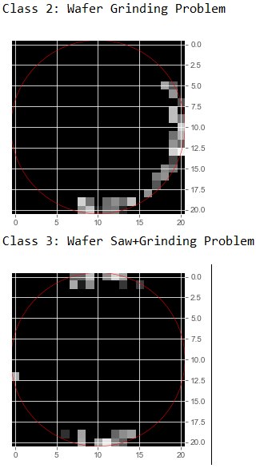
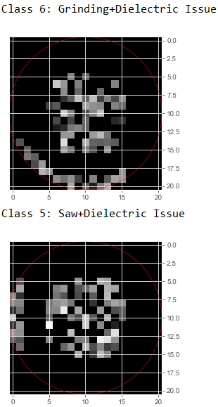
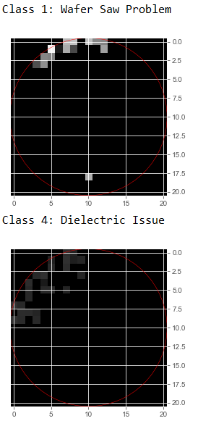
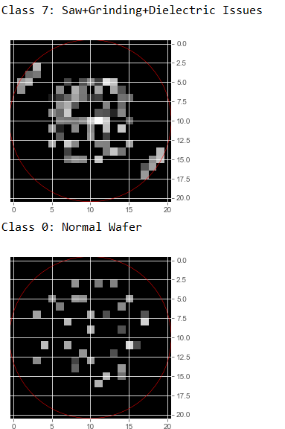
Types of Wafer Problems

Slide 5
Types of Wafer Problems
As discussed, wafer problems show up as identifiable patterns. From the wafer images, we could see that each type of wafer problem has a certain unique pattern. As a recap, there are 3 distinct problems related to wafer processes. Wafer Grinding, Wafer Saw and Dielectric.
Apart from the 3 distinct problems, we have 5 combinations of the distinct problems. For example, Grinding-Dielectric and Saw-Grinding.
Currently, it is through manual inspection that wafer problems are identified. For example, if the problem is due to Wafer Grinding, the pattern is at the edges with a certain orientation.
Dielectric (Material) problems manifest themselves in a certain pattern clustered towards the center of the wafer.
Wafer Saw problems appear at the edges too but with a different orientation to the Wafer Grinding related pattern.
We could have a combination of the aforesaid problems too, and these problems show up as a combination of the corresponding patterns.

Slide 6
Application of Deep Learning
In this project, we apply deep learning neural network on wafer maps with simulated faults.
The faults are classified into 8 classes and the neural network was trained to recognize them.
Being able to recognize a particular wafer problem using Deep Learning means that we could automate the identification of wafer testing, and reduce the time to sort out the bad wafers. Most importantly we could pin-point a specific issue with a particular upstream process and to rectify it.

Slide 7
Building the Dataset

Slide 8
Data Acquisition
In the manufacturing plant, technician will record their manual inspection observation in excel sheet. This will serve as the classification data.
Resistance measurement result will be saved in company database by automatic probe testing equipment and it is retrievable in csv format. This will serve as the input image.

Slide 9
Data Acquisition
After consulting subject matter expert, we found that
Technician Observation | Features
Normal | Scattering
Saw | Small scratch at the edge (not deep into the wafer, <45 degree). Failing edge parts in small angle. Need annotation of the direction of failing edge
Grind | Involves only edge in wider angle (>30 degree). Failing edge parts in large angle. Need annotation of the direction of failing edge.
Material | It usually fails in an obvious closed region in circle, horseshoe bend, doughnut, cluster. It might hit edge area but usually deep into the material.
Combination | Any combination can take place simultaneously.

Slide 10
Saw Image Acquisition based on Annotation

Slide 11
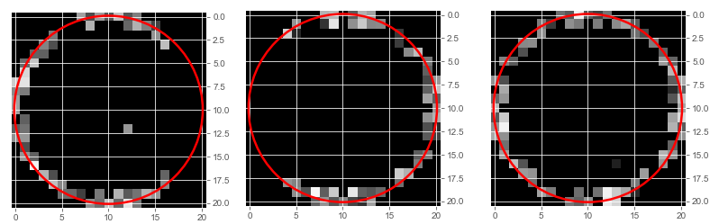
Grind Image Acquisition based on Annotation

Slide 12
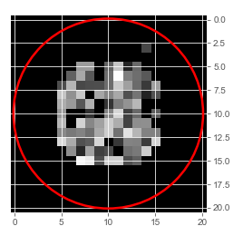
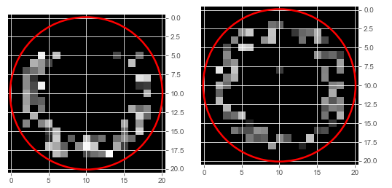
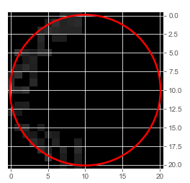
Material Issue – Based on failing patterns

Slide 13
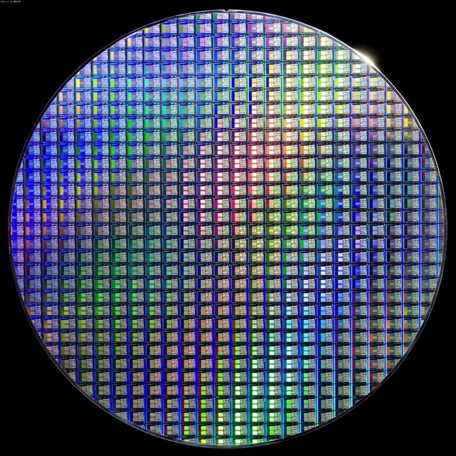
Data Generation
21
A data set was generated which reflects the outcome from a typical wafer metrology process. The data points are resistance measurements (in ohm) on each wafer. On each wafer, there are 441 locations (21x21) to be processed by the neural network. The generated data set contains test results from 1090 wafers.
21
21 x 21 = 441 data points

Slide 14
Data Generation
The 1090 wafer test results are put together based on:
Those with saw cut defects. Pure saw cut defects would cover 5-45 degrees of the wafer edge location.
Those with grind defects. Grind defects would cover 30-180 degrees of wafer edges. The dataset covers all cases where the center of grind defects are at 0,45,90,135,180,225,270,315 degrees on the wafer.
Those with dielectric defects. These are usually found at the center of the wafer. Severe dielectric issue causes the radius of affected area to be increased. The dataset covers the different radii of defect areas.
The dataset also covers normal wafer test cases with random defects.

Slide 15
Data Generation
For each data point, the range of the value is in between 0 and 500 ohm. The values which are close to 0 indicate that the corresponding data points are fault-free. Another way to look at this is that the semiconductor devices are conductive to electric currents with minimal resistance (small ohms). Those data points with failures show up with high resistance, up to 500 ohms.
The data points with high resistance form a certain pattern. The pattern correspond to a particular wafer problem, be it “Grind”, “Saw”, “Material”, or a combination of them.
Using Pattern Recognition, we could identify the specific problem that a wafer may have. Using Deep Learning, we could train a neural network to learn all the fault patterns so that it could recognize a particular problem with good accuracy.

Slide 16
Data Generation
A typical data set contains test results from the wafers. These test results are gathered and stored in excel file along with manual classification by the technician.
The technician classifies specify whether it is “Grind”,”Saw” or “Material” issue or combination based on manual inspection of the wafers. Hence, there will be 3 columns.
In our application, there are a total of 8 classes that the neural network will sort the problems into.
Our data set is of the exact format of the actual wafer test results and manual classifications.

Slide 17
Data Set Characteristics
Each row represents one wafer.
Each wafer has 21 x 21 = 441 data points (= 441 features).
The 21 column and 21 rows represent the cell locations on the wafer.
Each data point is a resistance measurement value at a particular cell location indicated by the Row and Col.
The resistance value can range between a small number close to zero to a maximum value of 500 ohms.
High resistance value measured at a cell location indicate that the particular cell is defective.
Typically high resistance is > 50 ohm.
Low resistance values are usually small values < 1 ohms

Slide 18
Data Set Creation Steps
A set of raw wafer test results was collected and entered into a spreadsheet -ID_Selected.xls.
Each row of the raw data file contains the wafer unique ID and the corresponding defect classification (manually classified).
When entering the raw data into the ID_Selected.xls, we ensured that each defect has a proportional number of samples.
A resulting 1090 rows (out of the 10000+) are selected this way., such that we have a set of data with a good representation of all the defects.
Based on the selected wafer IDs, a raw data file with 441 resistance values for each of the corresponding wafer IDs are then collated –raw_data.csv
Dummy high resistance values (>50) were generated to replace the high resistance values in the designated locations.
Correspondingly, dummy low resistance values were generated to replace the low values in the spreadsheet.
Technician observation data containing manual defect classification for all the selected wafers are obtained in excel format. (see TechnicianObservationData.xlsx)
The two files are merged (based on wafer IDs) into final data td6.xlsx.
The wafer IDs are then replaced with ascending values 1 to 1090.
Each line represents all resistance data with its classification result.

Slide 19
Data Cleansing and Processing
IDs are removed from the database, hence the result are ready to be used for the deep neural network.
Panda is used to extract the data from excel sheet.
Inputs are output are then extracted as panda dataframe.
20% test train split is applied on the data.
Convert the split data into numpy array.
The array is then scaled. Since 500ohm is the measurement limit, all the data is divided with 500.

Slide 20
Data Preparation
raw_data = pd.read_excel('td6.xlsx',sheet_name = "td6") #raw data
sdarray=raw_data.drop(["saw","grind","dielectric"],axis=1) #Just the features. Drop the outputs
raw_label=raw_data.saw+2*raw_data.grind+4*raw_data.dielectric #The result. Combining 3 rows into value of 0 to 7
sdarray_train,sdarray_test,label_train,label_test = train_test_split(sdarray,raw_label,test_size = 0.2) #split test data
sdarray_train_np=sdarray_train.as_matrix() #Changing input format
twoDarray_train = sdarray_train_np.reshape((sdarray_train_np.shape[0], 21, 21)) # reshape data format to 2D
sdarray_test_np=sdarray_test.as_matrix()
twoDarray_test = sdarray_test_np.reshape((sdarray_test_np.shape[0], 21, 21)) # reshape data format to 2D
trDat=twoDarray_train
trLbl=label_train
tsDat=twoDarray_test
tsLbl=label_test
trDat = trDat.astype('float32')/500 #Convert ohm value to 1
tsDat = tsDat.astype('float32')/500 #
The data set containing test results on 1090 wafers were put together in an Excel file along with manual classifications.
The data set was split into train and test portions.
Each row in csv file represents 1 wafer and hence the need to reshape the raw data into 2D numpy array after test and train data split

Slide 21
Data Preparation
# Retrieve the row size of each image
# Retrieve the column size of each image
imgrows = trDat.shape[1]
imgclms = trDat.shape[2]
# reshape the data to be [samples][width][height][channel]
# This is required by Keras framework
trDat = trDat.reshape(trDat.shape[0],
imgrows,
imgclms,
1)
tsDat = tsDat.reshape(tsDat.shape[0],
imgrows,
imgclms,
1)
# Perform one hot encoding on the labels
# Retrieve the number of classes in this problem
trLbl = to_categorical(trLbl)
tsLbl = to_categorical(tsLbl)
num_classes = tsLbl.shape[1]
The input was converted to categorical value.
Number of classes is also accounted.

Slide 22
Data Preparation
# Retrieve the row size of each image
# Retrieve the column size of each image
imgrows = trDat.shape[1]
imgclms = trDat.shape[2]
# reshape the data to be [samples][width][height][channel]
# This is required by Keras framework
trDat = trDat.reshape(trDat.shape[0],
imgrows,
imgclms,
1)
tsDat = tsDat.reshape(tsDat.shape[0],
imgrows,
imgclms,
1)
# Perform one hot encoding on the labels
# Retrieve the number of classes in this problem
trLbl = to_categorical(trLbl)
tsLbl = to_categorical(tsLbl)
num_classes = tsLbl.shape[1]
The input was converted to categorical value.
Number of classes is also accounted.

Slide 23
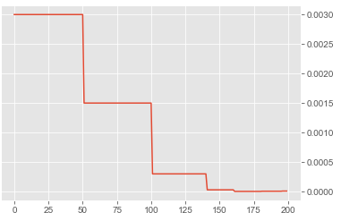
Learning Rate Setting
Applying initial learning rate at the beginning, and applying step wise decay when setting the learning scheduler.

Slide 24
Training the Neural Network – Standard Neural Network
We started with the standard convolutional neural network which gave us an accuracy of
91.74%
def createModel():
model = Sequential()
model.add(Conv2D(20, (5, 5), input_shape=(21, 21, 1), activation='relu'))
model.add(MaxPooling2D(pool_size=(2, 2)))
model.add(Conv2D(40, (5, 5), activation='relu'))
model.add(MaxPooling2D(pool_size=(2, 2)))
model.add(Dropout(0.2))
model.add(Flatten())
model.add(Dense(128, activation='relu'))
model.add(Dense(num_classes, activation='softmax'))
model.compile(loss='categorical_crossentropy', optimizer='adam', metrics=['accuracy'])
return model

Slide 25
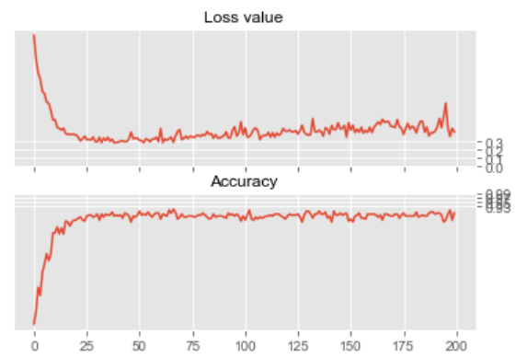
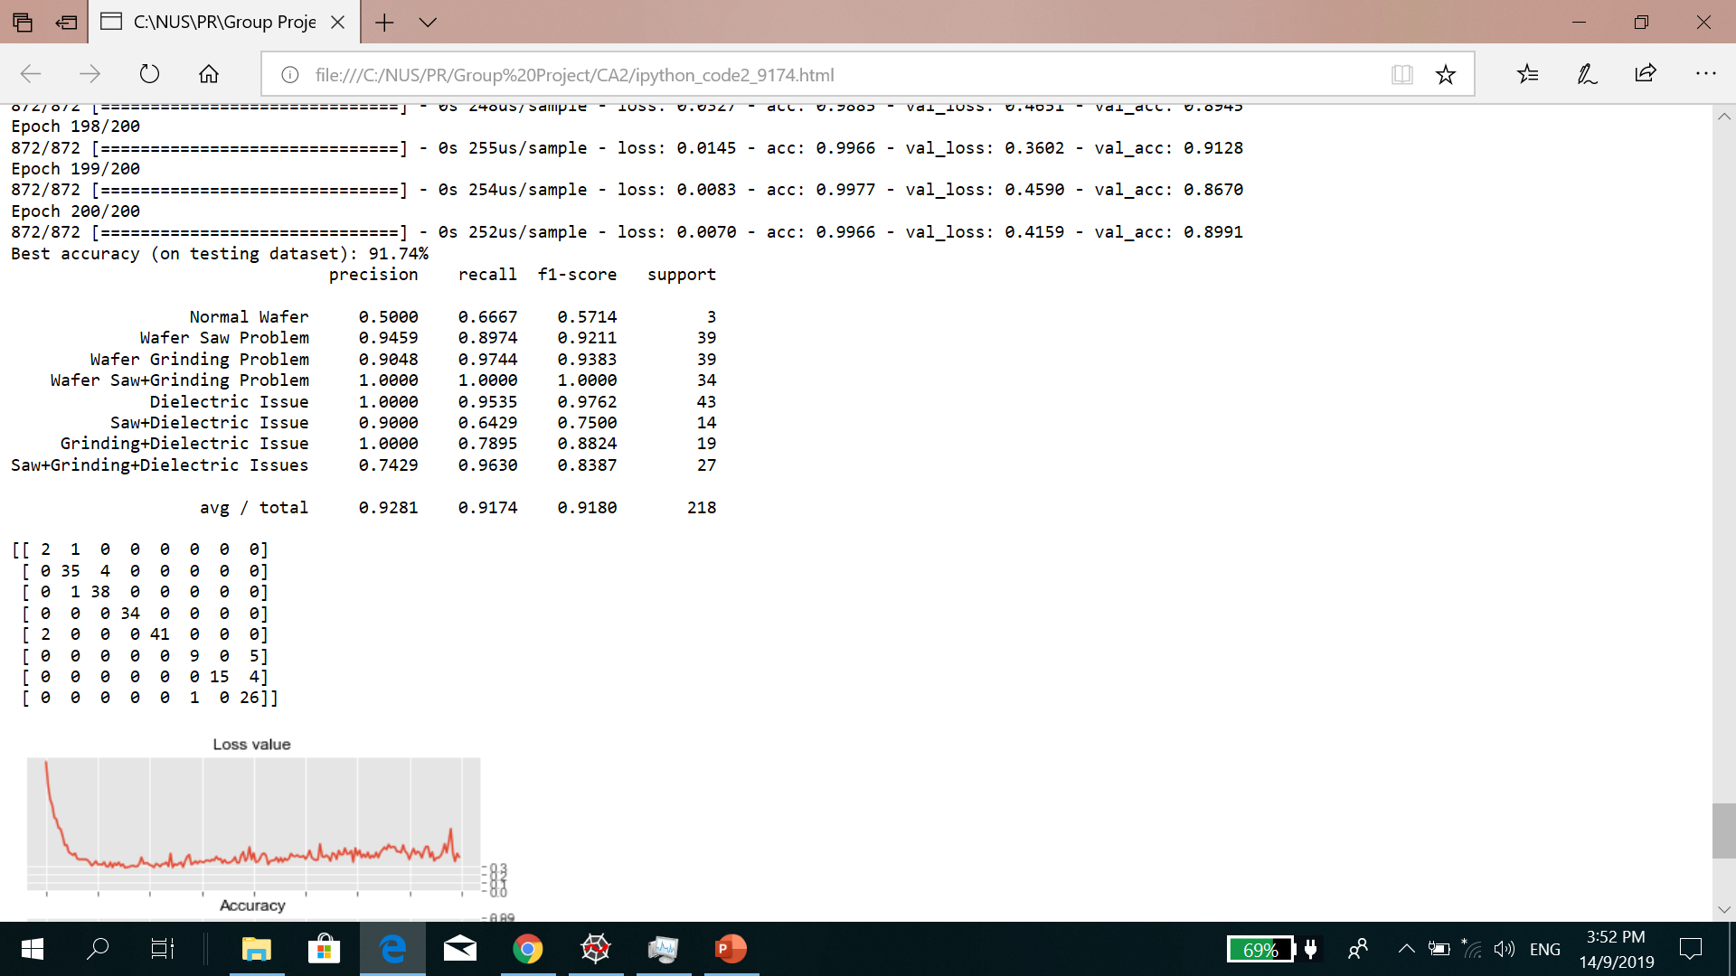
Results
Standard Neural Network
Original Convolutional Neural Network
Learning Rate = 2e^-3
Batch Size = 32
Loss value starts to increase…
Best accuracy (on testing dataset): 91.74%
Confusion Matrix

Slide 26
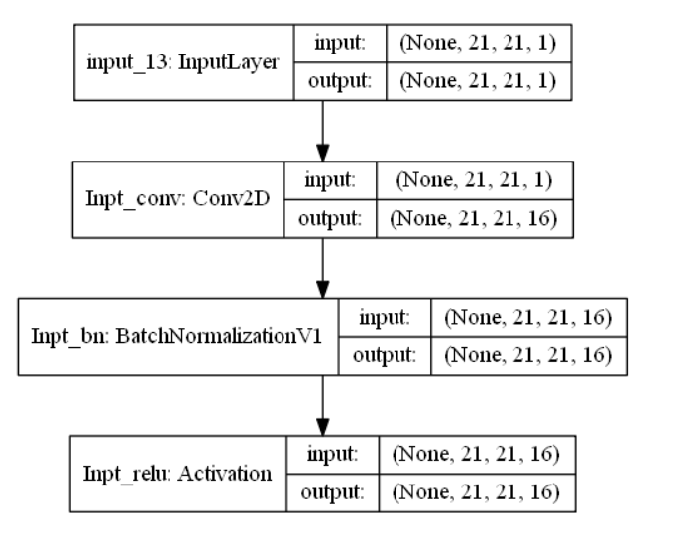
Incorporating the Resnet
Input Layers
The input shape is (21,21,1)
16 Neurons of conv2D followed by batch normalization and RELU activation layer.
The output shape becomes (21,21,16)

Slide 27
Residual Net Layer – resBlkV1
Consists of 3 blocks for each resBLKV1.
3 resBLKV1 are cascaded after input Residual layer.
After each residual layer, size of the image is reduced.
(21,21) -> (11,11)->(6,6)->(3,3)
After each residual layer, number of neurons increased.
16->32->64->128

Slide 28
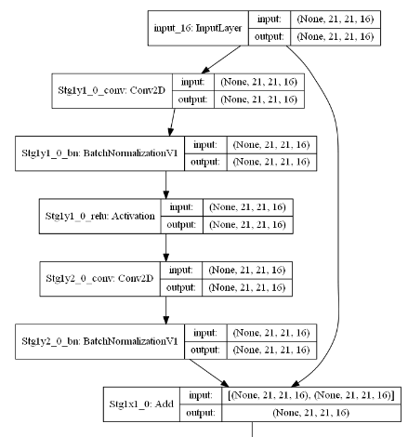
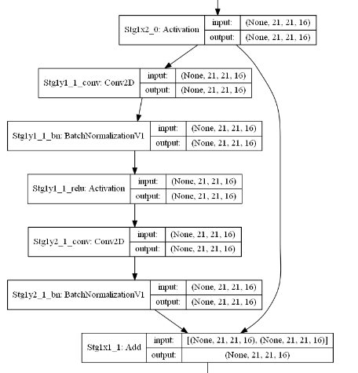
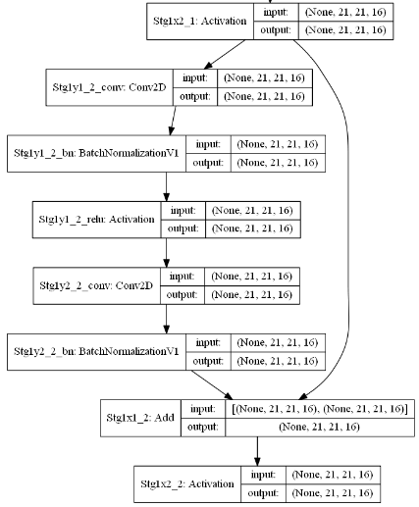
Incorporating the Resnet
Block 1
Block 2
Block 3

Slide 29
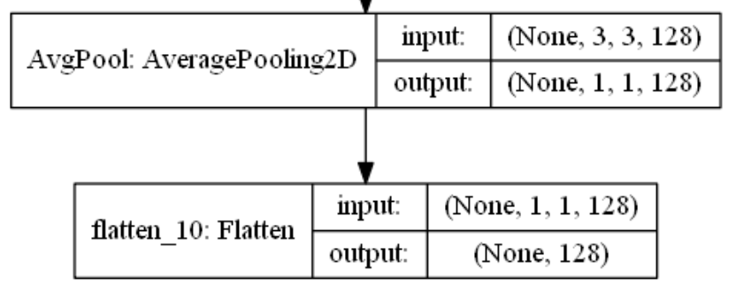
Final Layers
The average pooling layers are used to average out the value from final image of (3,3) into just (1,1).
Flattened layer forms the final 1D layer.
Dense at output layer will give the final prediction value for the class.
In total, 1,392,864 parameters are used.

Slide 30
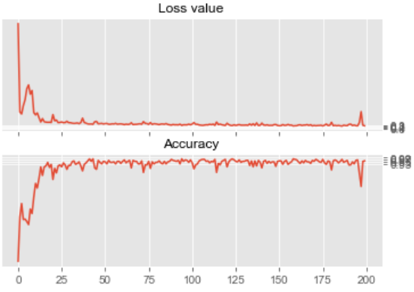
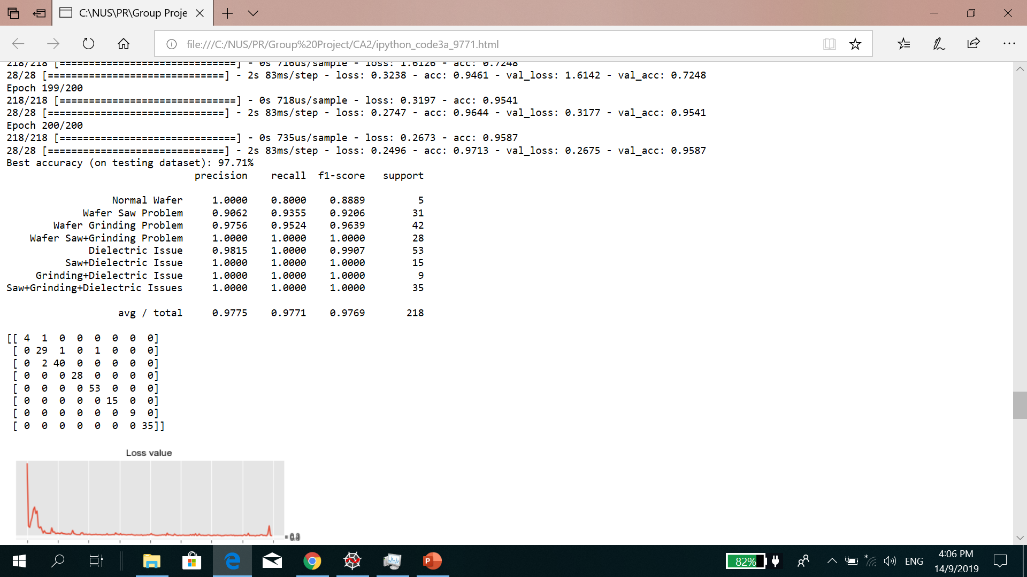
Improved Results with Resnet – 1st Attempt
HYPER-PARAMETERS
Using Resnet layers
Learning Rate = 2e^-3
Batch Size = 32
Best accuracy (on testing dataset): 97.71%
Confusion Matrix

Slide 31
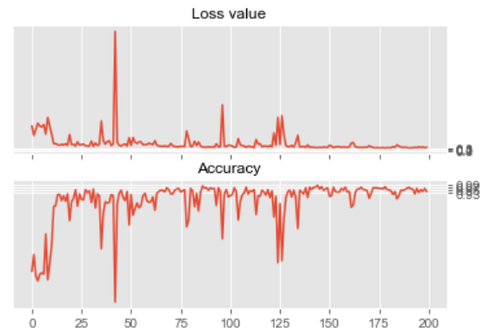
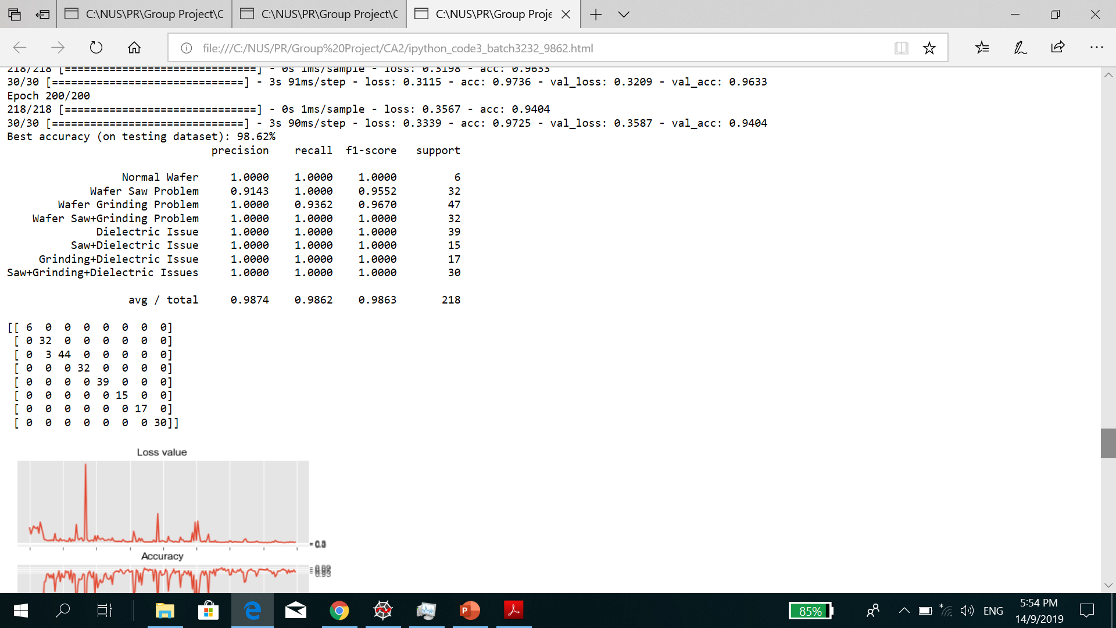
Improved Results with Resnet – 2nd Attempt
HYPER-PARAMETERS
Using Resnet layers
Learning Rate = 1e^-3
Batch Size = 32
Best accuracy (on testing dataset): 98.62%
Confusion Matrix

Slide 32
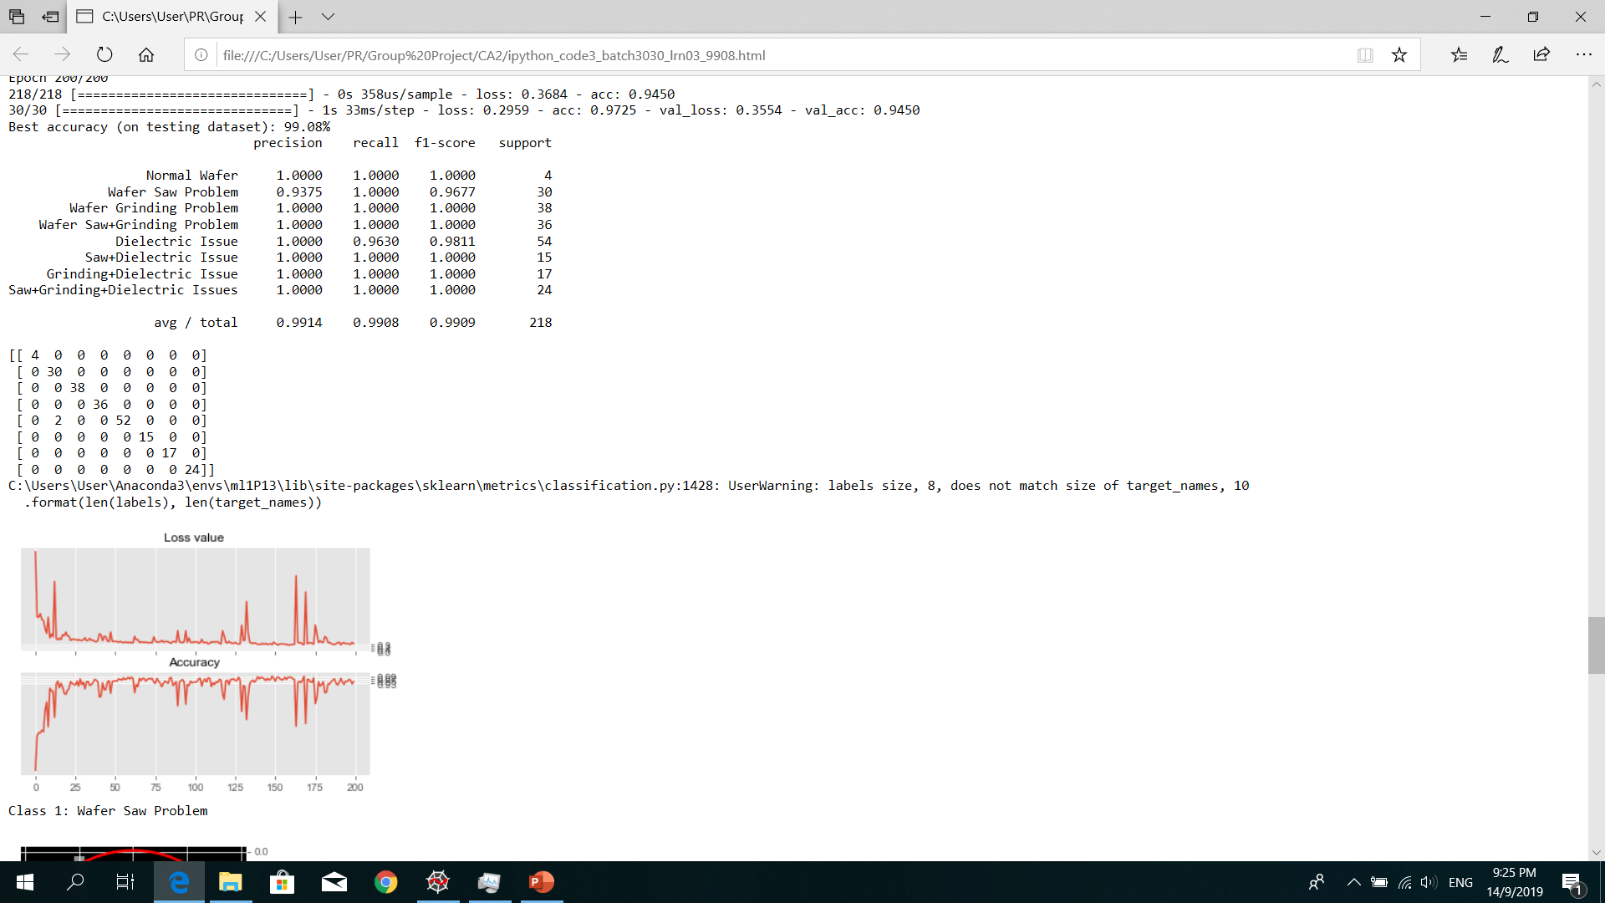
Improved Results with Resnet – Final Attempt
HYPER-PARAMETERS
Using Resnet layers
Learning Rate = 0.3e^-3
Batch Size = 30
Best accuracy (on testing dataset): 99.08%
Confusion Matrix

Slide 33
Conclusion
Successful Wafer Failure Identification
This project enabled us to successfully apply pattern recognition techniques to identify the different types of wafer failures. Using the standard convolution algorithm, we are able to do the failure classification with a decent accuracy of 91.74%.
Pursuit of Higher Accuracy
Accuracy is improved through the use of Resnet to increase the number of layers in the algorithm and tuning the parameters, achieving a final accuracy of 99.08%.

